Slide 1


Automatic Summarization for Long Biomedical Documents
Chung-Fan Tsai
Research Questions
1. How can we efficiently summarize texts longer than a model’s input token limit?
2. Is there a cost-effective evaluation metric that judges summaries beyond its extractive capability?
Final abstract from all chunks
 | Biomedical Expert | AmazonMech.Turks | GPT3.5
Cost (approx.) | A lot | $1.9k - $3k | $2
Man hours (approx.) | 280 | 280 | < 2
Quality | High | Medium low | Medium - high
…
Concatenate & repeat chunking & summarizing
Abstract 1
+
Abstract 2
Abstract 3
+
Abstract 4
Summarize
Chunk 1
Chunk 2
Chunk 3
Chunk 4
Fixed chunking with overlap
Full Article

Slide 2
Automatic Summarization for Long Biomedical Documents
Chung-Fan Tsai
Research Questions
1. How can we efficiently summarize texts longer than a model’s input token limit?
2. Is there a cost-effective evaluation metric that judges summaries beyond its extractive capability?
Final abstract from all chunks
 | Biomedical Expert | AmazonMech.Turks | GPT3.5
Cost (approx.) | A lot | $1.9k - $ 3k | $2
Man hours (approx.) | 280 | 280 | < 2
Quality | High | Medium low | Medium - high
…
Concatenate & repeat chunking & summarizing
Abstract 1
+
Abstract 2
Abstract 3
+
Abstract 4
Summarize
Chunk 1
Chunk 2
Chunk 3
Chunk 4
Fixed chunking with overlap
Full Article

Slide 3

Research Questions
How can we efficiently summarize texts longer than a model’s input token limit?
Is there a cost-effective evaluation metric that judges summaries beyond its extractive capability?

Slide 4
Solving Input Length Limit
Using models with longer input capacity
Shortening the input text
Recursive summarizing

Slide 5
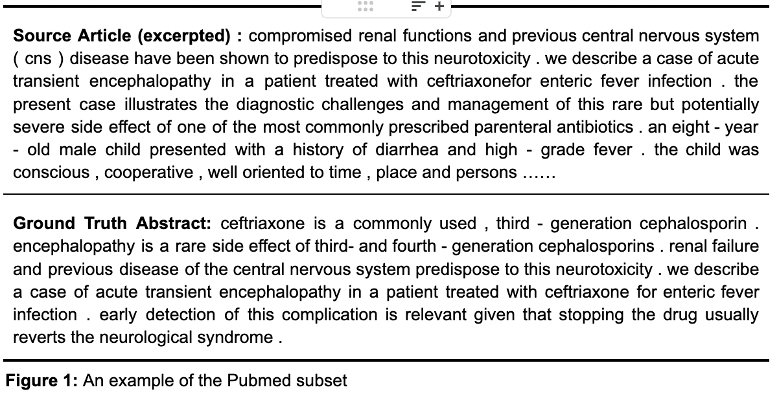
Dataset
13k Biomedical articles and abstracts taken from PubMed

Slide 6
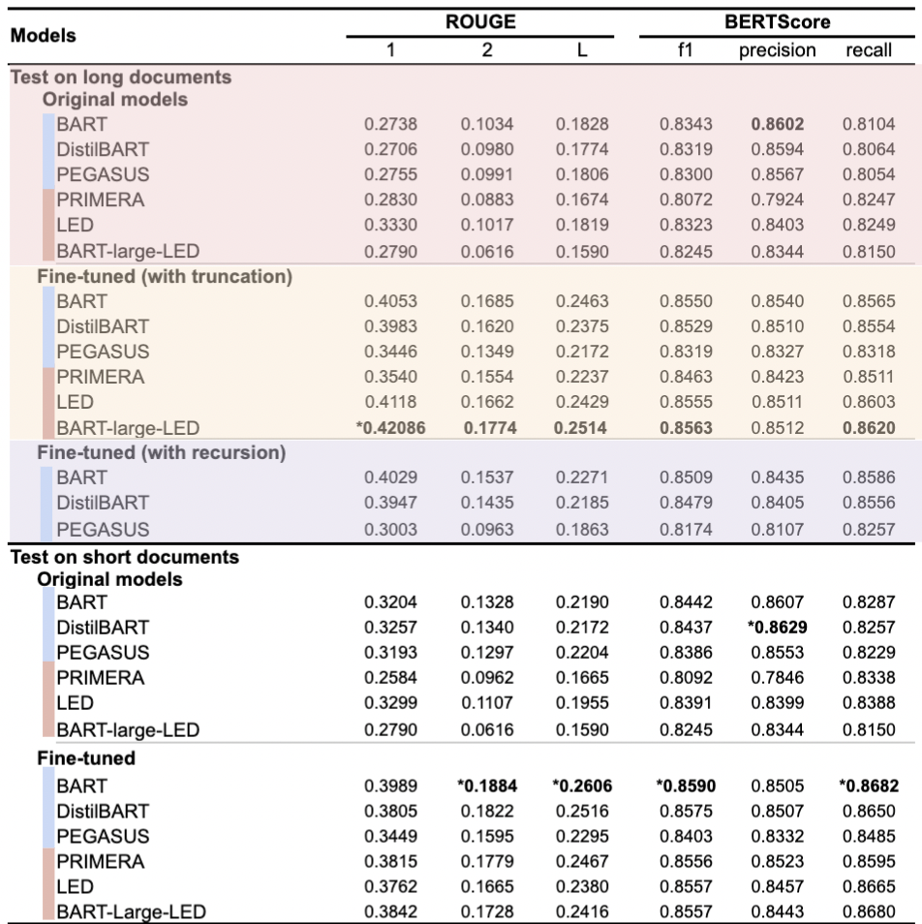
PubMed Dataset: Short Input Subset
Articles with less than 1024 tokens
Compare performance of long (4096+ tokens) and short (1024 tokens)input models, given the entire text
short and long input models

Slide 7
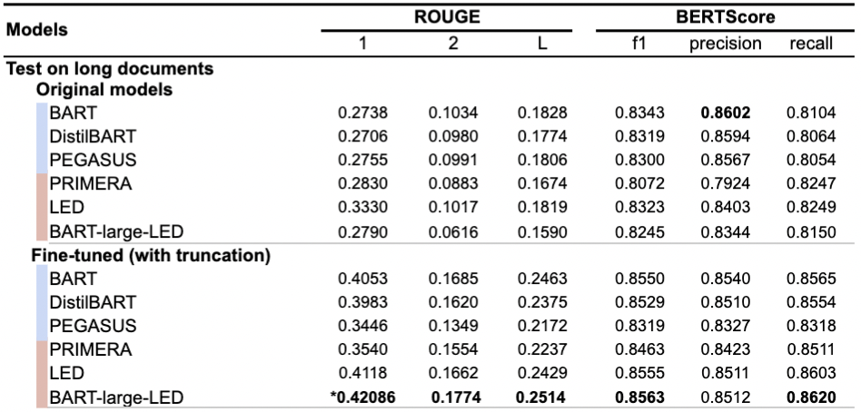
PubMed Dataset: Long Input Subset
Articles with more than 1024 tokens but less than 4096 tokens
Compare performance of long (4096+ tokens) and short (1024 tokens)input models
short and long input models

Slide 8
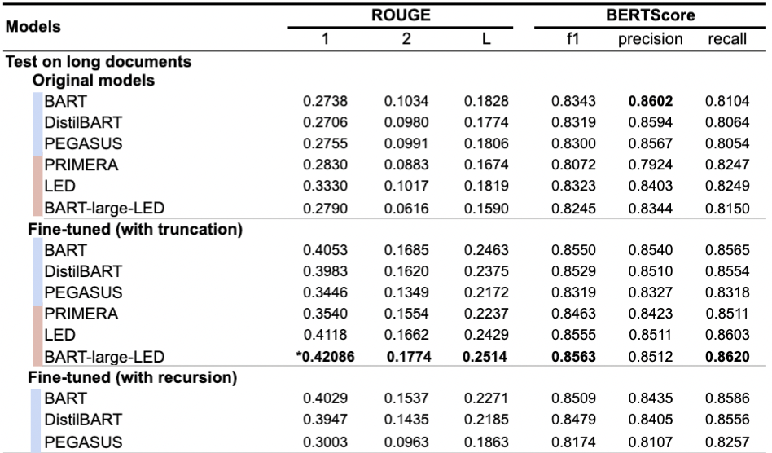
PubMed Dataset: Long Input Subset
Articles with more than 1024 tokens but less than 4096 tokens
Compare performance of long (4096+ tokens) and short (1024 tokens)input models and recursive summarizing
short and long input models

Slide 9
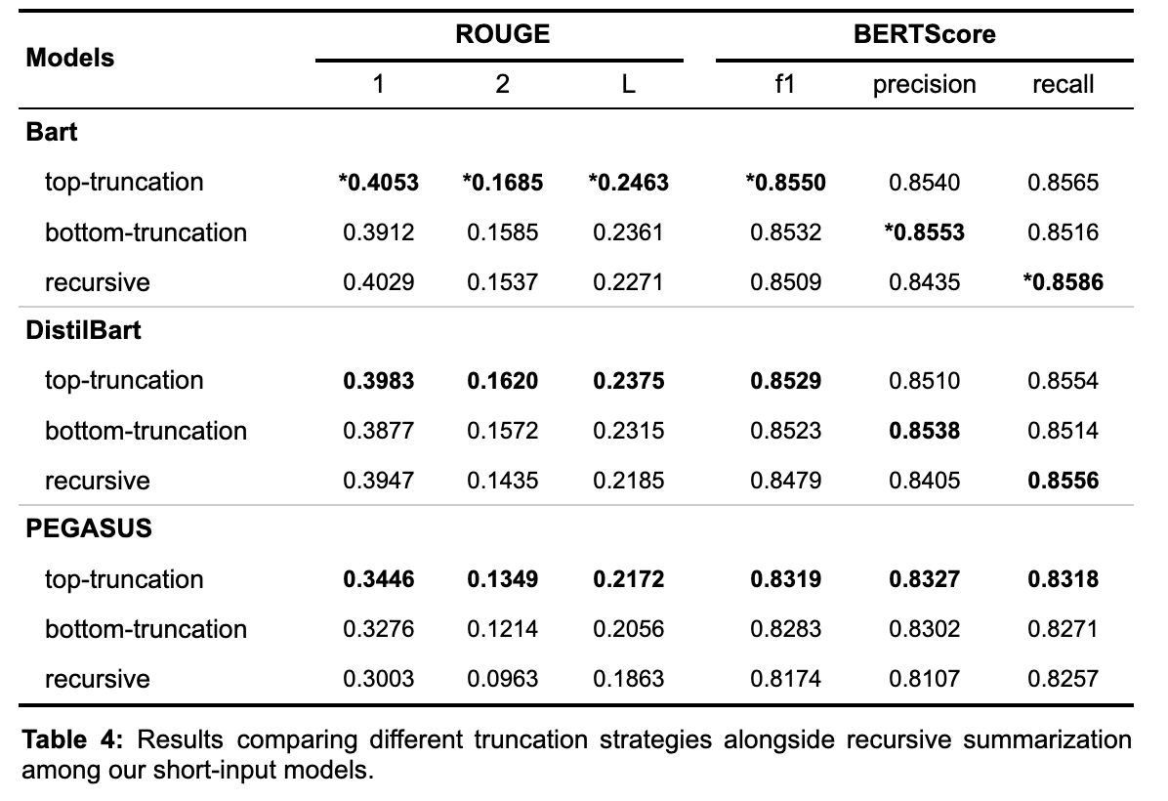
Truncation Styles

Slide 10
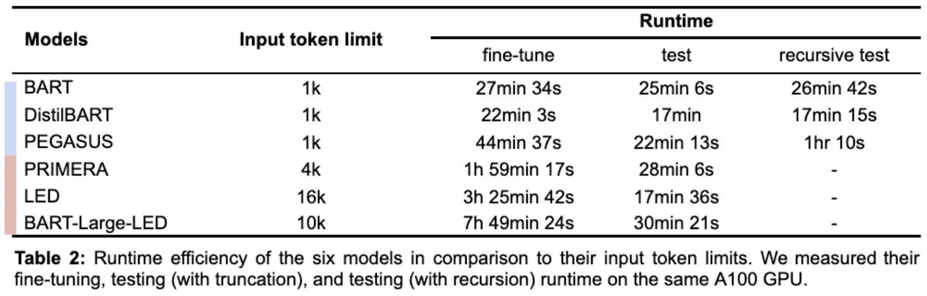
Efficiency
Compare runtime of long (4096+ tokens) and short (1024 tokens)input models and recursive summarizing on the same GPU
short and long input models

Slide 11
GPT-prompted Fluency Metric
Our sample study shows that GPT evaluation generally aligns with human evaluation
GPT 3.5-prompted evaluation costs $1.8 instead of $1909-3182 if we hire Amazon Mechanical Turk
Notes:
Document Understanding Conferences - Guidelines

Slide 12
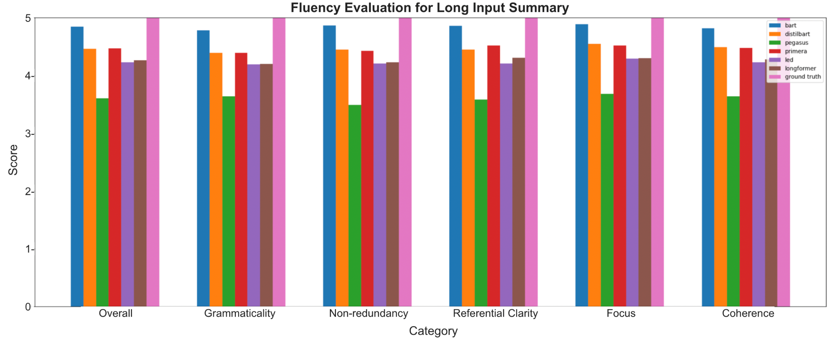
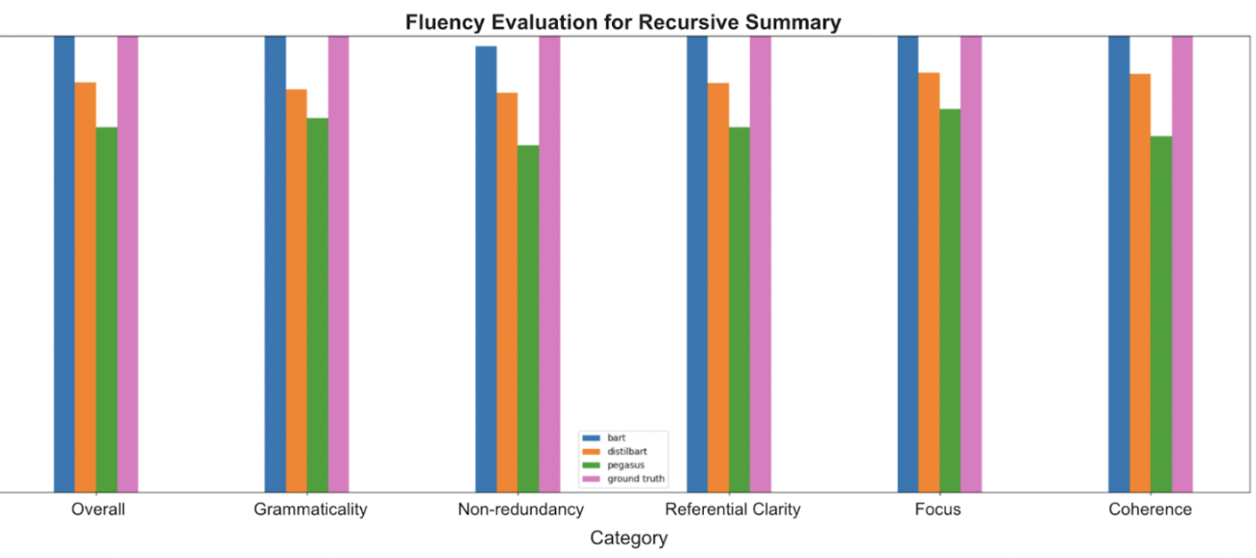


GPT-prompted Fluency Metric
Following DUC Guidelines to evaluate fluency from 5 aspects: Grammaticality, Non-redundancy, Referential Clarity, Focus, and Structure & Coherence from 1(very poor) to 5(very good)
Notes:
Document Understanding Conferences - Guidelines
https://www-nlpir.nist.gov/projects/duc/duc2007/quality-questions.txt

Slide 13
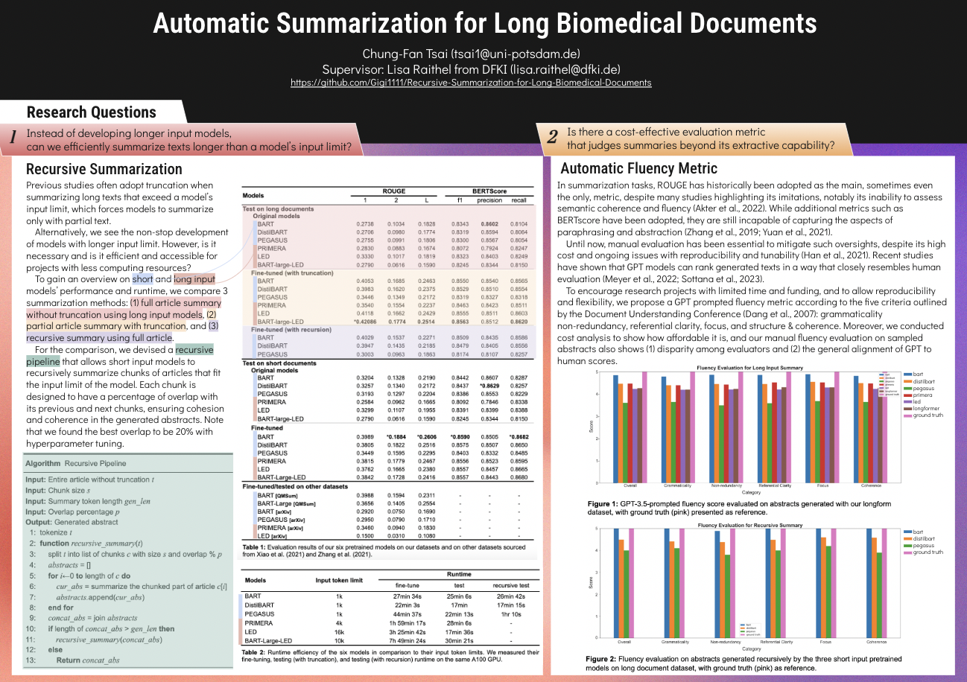
Thank You
Notes:
Document Understanding Conferences - Guidelines
https://www-nlpir.nist.gov/projects/duc/duc2007/quality-questions.txt

